Slide 1
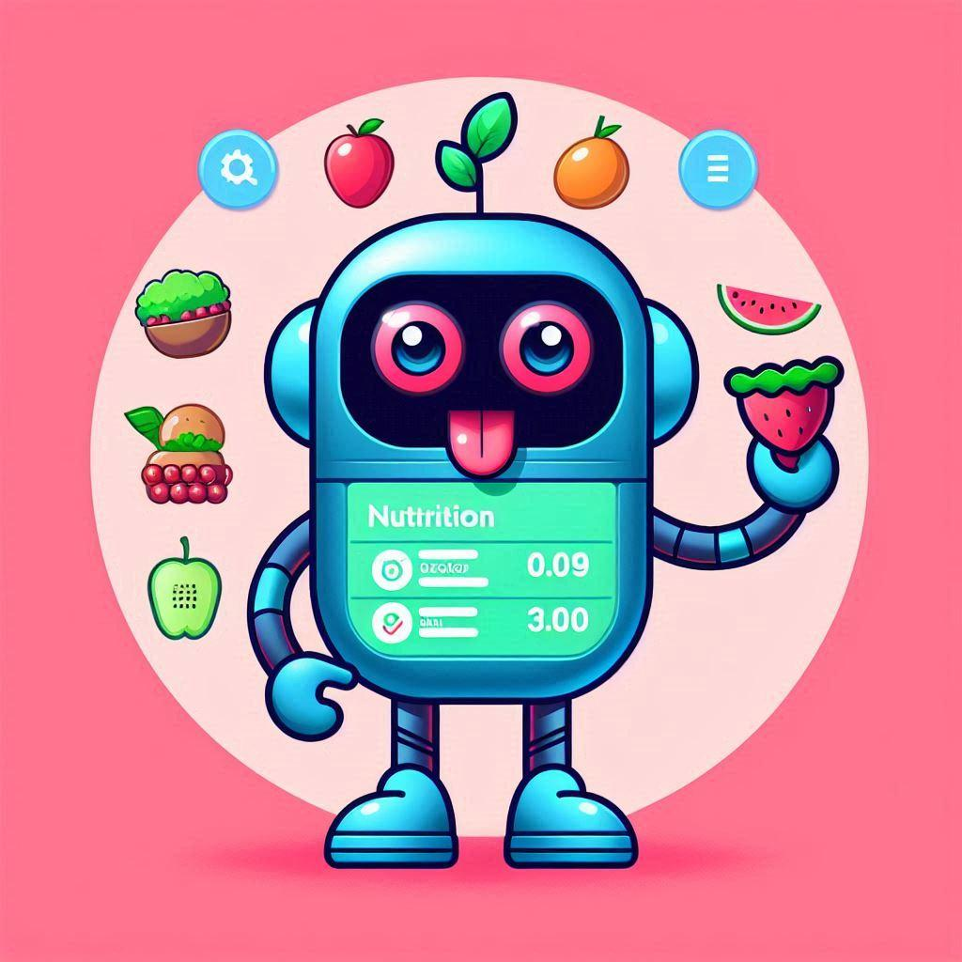
Bite buddy bot
Bayan Kassem
Or Hasan
Mohammad Imad

Slide 2
The problem
You want to simply track your nutrition intakes without downloading applications.
you want to only view the nutrition values for your eaten food, without any sophisticated scientific information.
You want AI based advices corresponding to what you have eaten quickly.

Slide 3
Future
Integrate the bot with groups so the whole family can track their nutrition values.
Challenges and achievements.

Slide 4
Technologies
Python
MongoDB
API’s: google-genai API, nutritionix API

Slide 5
Conclusions
We learned how to work in a team.
We learned how to deal with deadlines, and to deliver products in time.
We tried our best to avoid git conflicts.

Slide 6
Questions

